Slide 1
MAHATMA GANDHI
By:
ANDREA CATALINA REYES MONTOYA
LAURA JULIANA REYES MOTNOYA

Slide 2
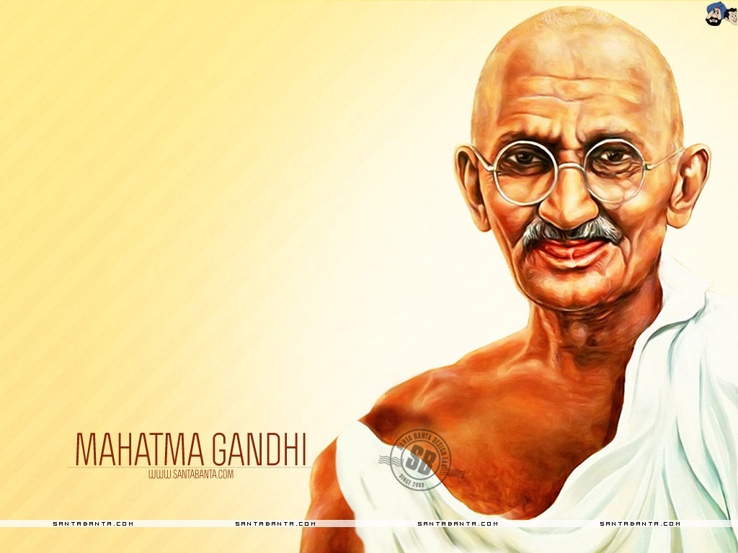

Slide 3
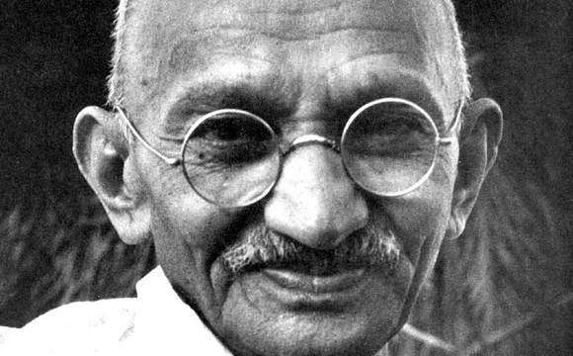

Slide 4
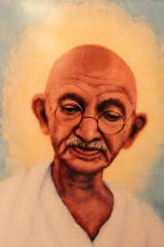

Slide 5
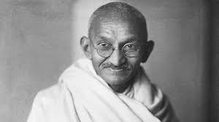

Slide 6
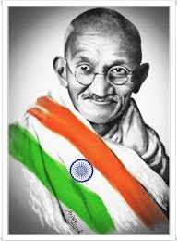

Slide 7
